Slide 1


Databases Coursework
ISAD253SL – Group 21

Slide 2

LIBRARY MANAGEMENT SYSTEM

Slide 3
INTRODUCTION
In our library system we have multiple tables that store information about books, borrowers, issue of books, publishers, library locations, staff, copy of books and authentication system information.

Slide 4
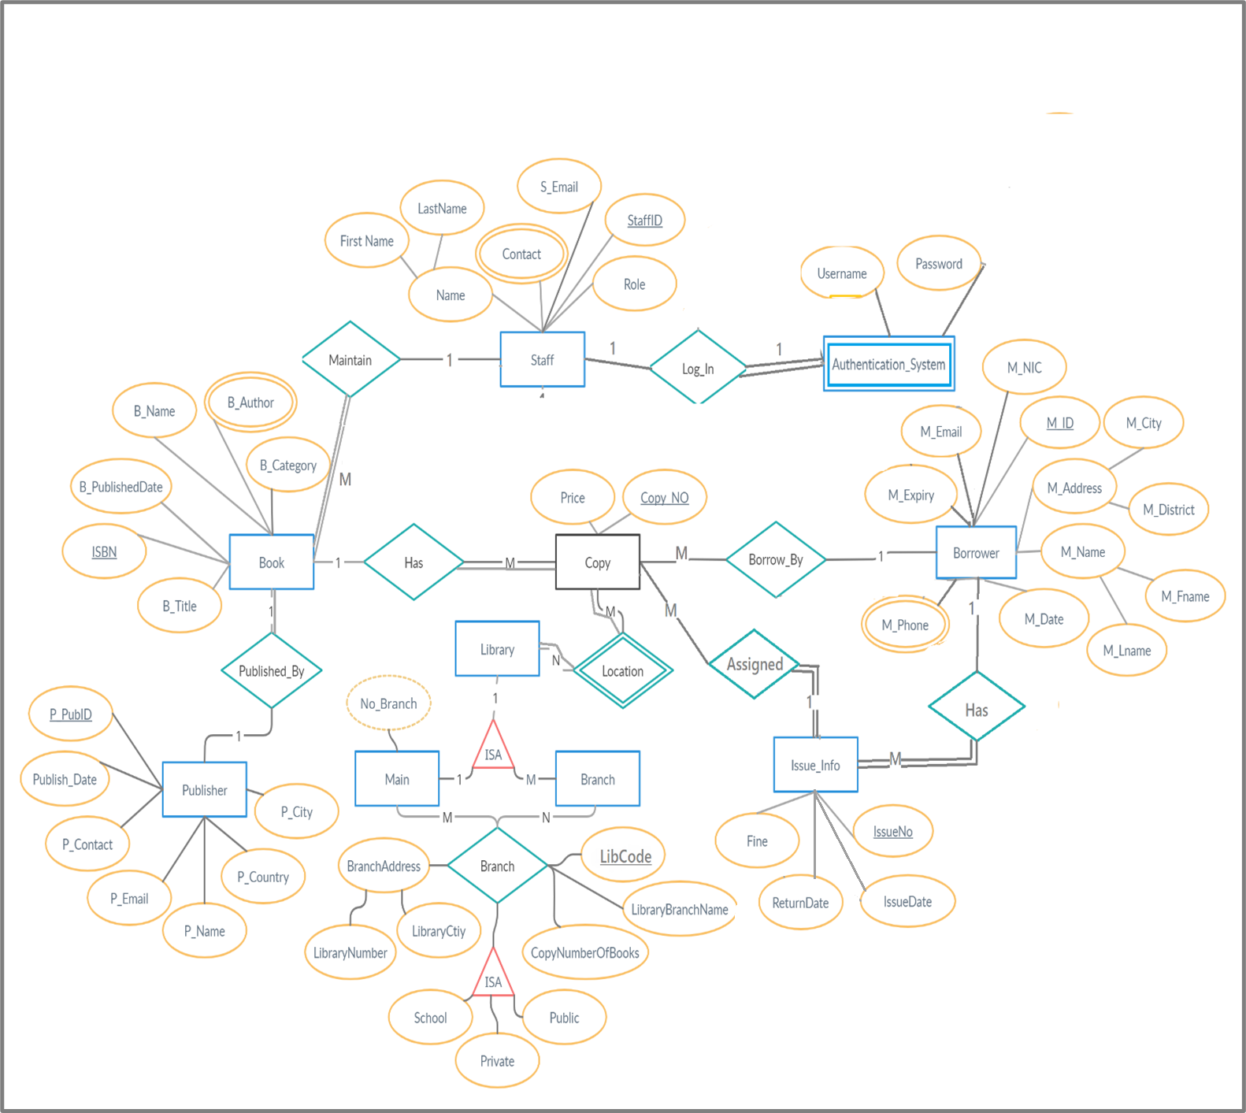
EER DIAGRAM

Slide 5
ASSUMPTIONS
A book can have one or more authors (B_Author)
The name published date and category of the book is also additionally recorded
A borrower can have one or more phone numbers (M_Phone)
A borrower’s address (M_Address) consist of 2 parts city (M_City) & district (M_District), his\hers address can be null.
A borrower’s name (M_Name) consist of 2 parts first name (M_Fname) & second name (M_Lname).
A borrower’s unique NIC (M_NIC), unique email (M_Email), start of membership date (M_Date) and membership expiry date (M_Expiry) is also recorded as it provides clear information and to properly identify the borrower.
Added IssueInfo table to save issued books data.
An IssueInfo table attributes are Issue number (IssueNo- which is increment automatically), Fine, Issue date (IssueDate), Return date (ReturnDate).
A Library can have a main with many branches or no branches however a branch cannot be created without a main (Library) (main) (branch)
Each library should have a name which is not null (BranchName)
Further the number of copies recieved to each branch is recorded (CopyNumber)
Assuming that there are many types of libraries the following attributes are additionally created (public)(private)(school) are broken down by the relationship from the (branch)

Slide 6
(BranchAddress) is created assuming that each library has an address which is not null since it is compulsory.
After considering the above scenario we have added two adiitional attributes of published city (Pub_City) and publisher E-mail (Pub_Email) inorder to provide more information about the publisher.
Publisher ID (Pub_ID) is the primary key.
We assume that publisher contact (Pub_Contact) and publisher e-mail (Pub_Email) addresses are not multi-valued attributes and can record only one value for each of the publisher data input
Staff entity has attributes named, Name, Contact, Email, StaffID (primary key which is set to incremented) and Staff Role
Staff members are required for library to check status of resources.
StaffID is the primary key for staff members as it helps to uniquely identify each single member.
Staff members who want log into the system are required to provide the valid username and password. Using username and password can prevent unauthorized parties to login the system.
Staff members who have thier role set to admin are considered as administrators and only them can login the system.
Name of the staff members are breaked into first and last name in separate fields to identify easily.
Contact of members are added within a multivalued attribute because a member can have one or more contact numbers.
Through successful authentication system, anyone can see the details of resources as well as manage them too.
By checking the details of resources, library can make their own analysis as it will help them make decisions as well.

Slide 7
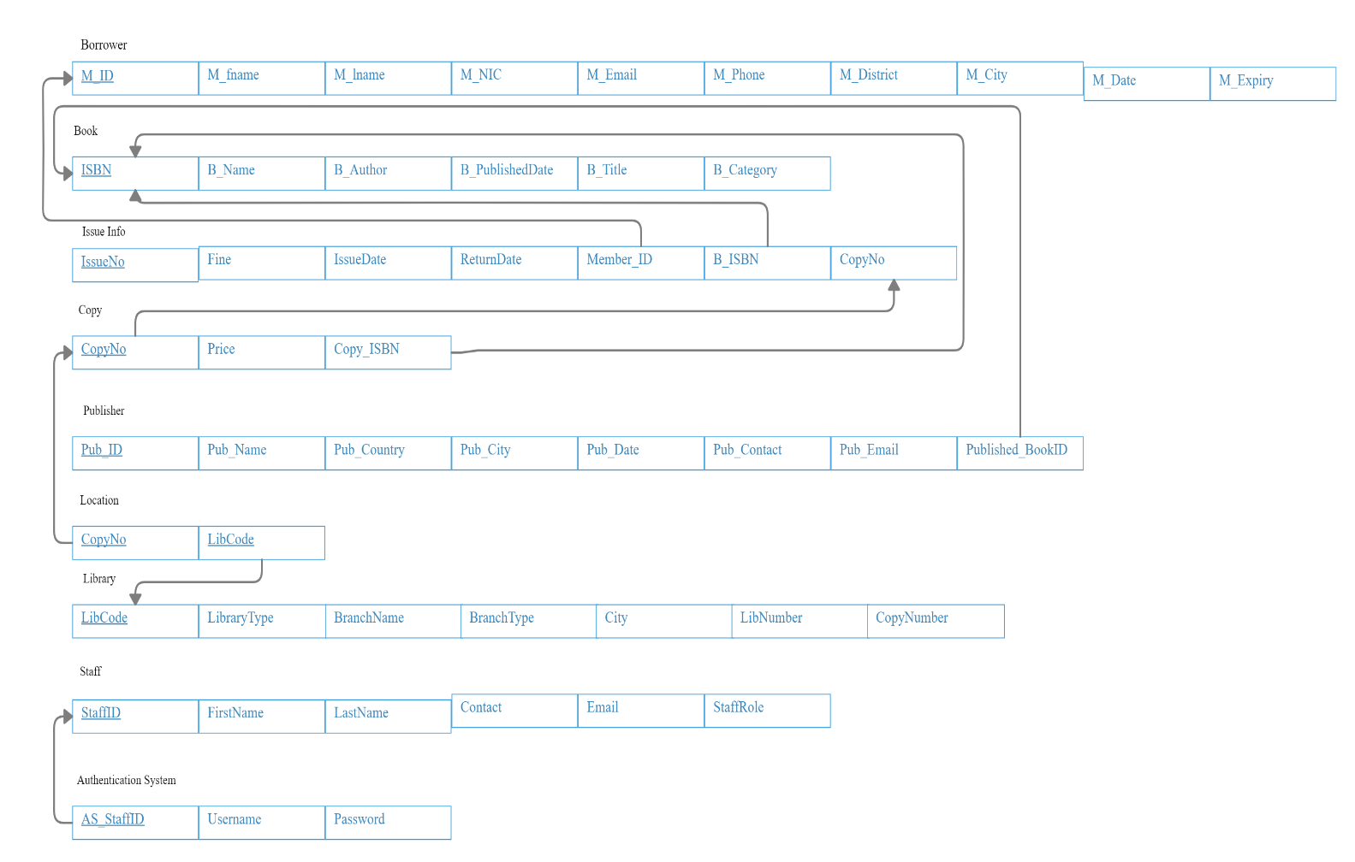
RELATIONAL MAPPING

Slide 8
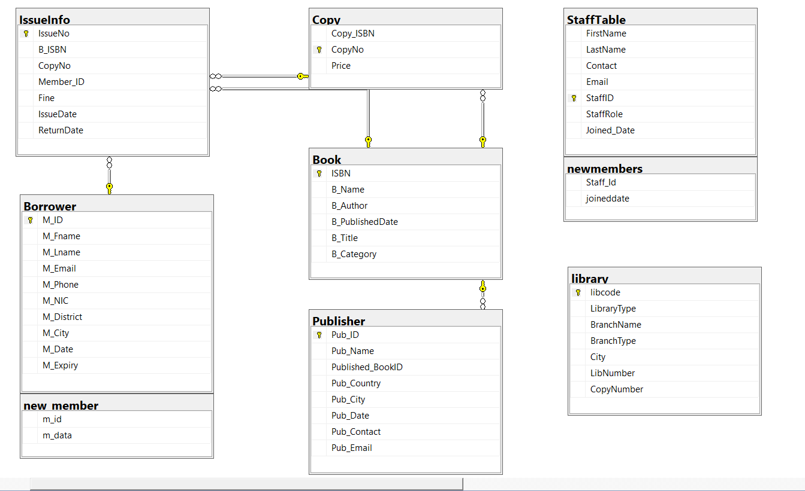
DB DIAGRAMS

Slide 9
BOOK TABLE

Slide 10
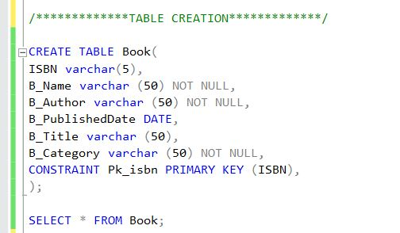
Book Table
TABLE CREATION AND CONSTRAINT
The number of attributes that I have added are five attributes where the ISBN is the Primary Key and I have used only a Constraint for the Primary Key.

Slide 11
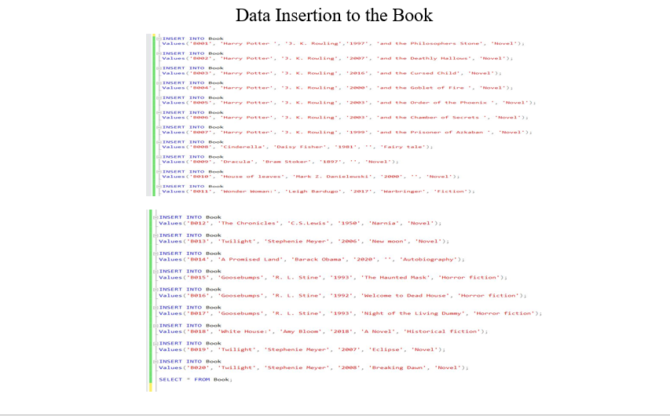

Slide 12
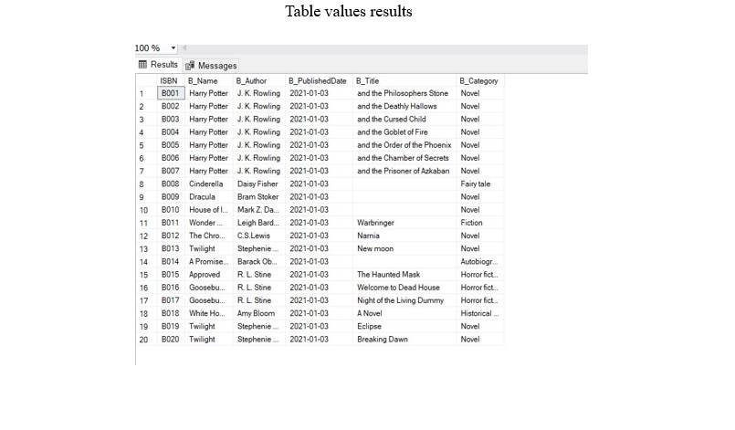

Slide 13
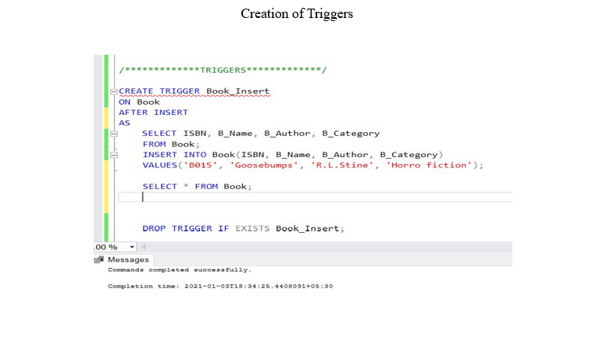

Slide 14
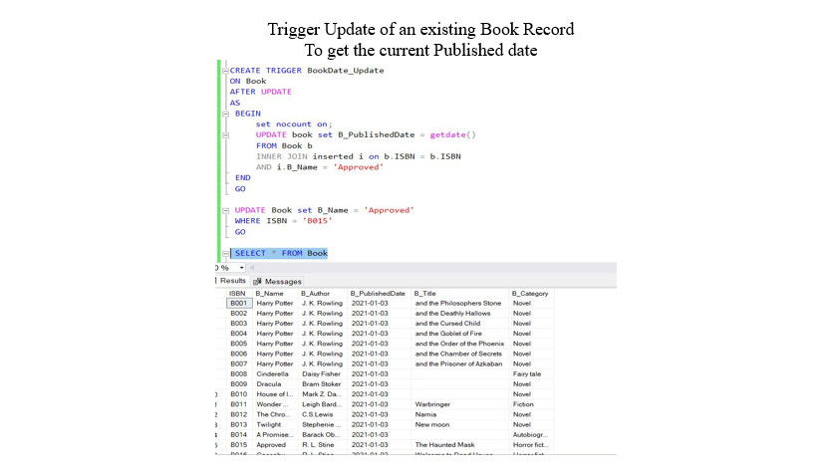

Slide 15
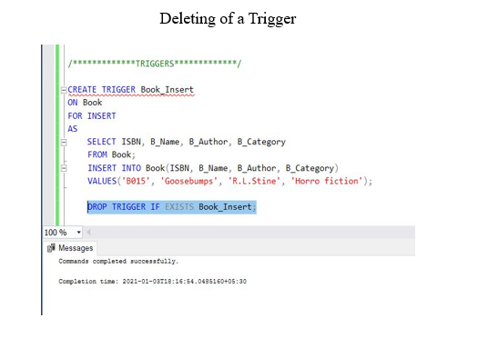

Slide 16
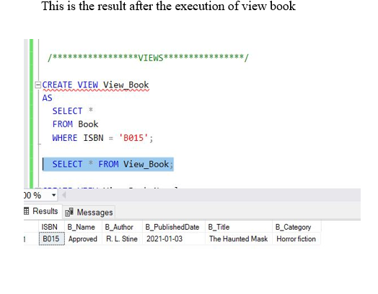

Slide 17
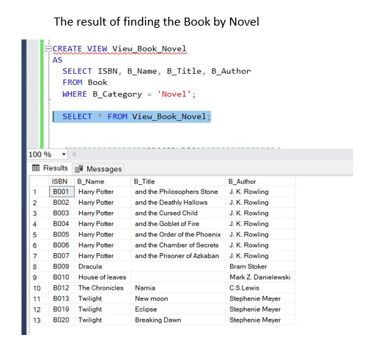

Slide 18
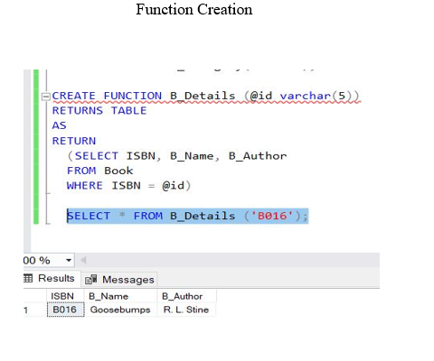

Slide 19
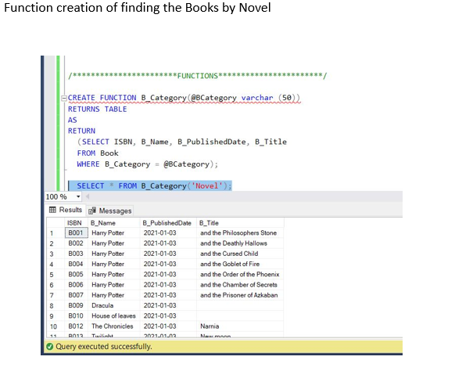

Slide 20
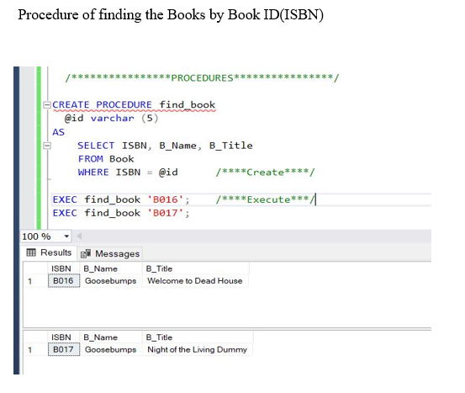

Slide 21
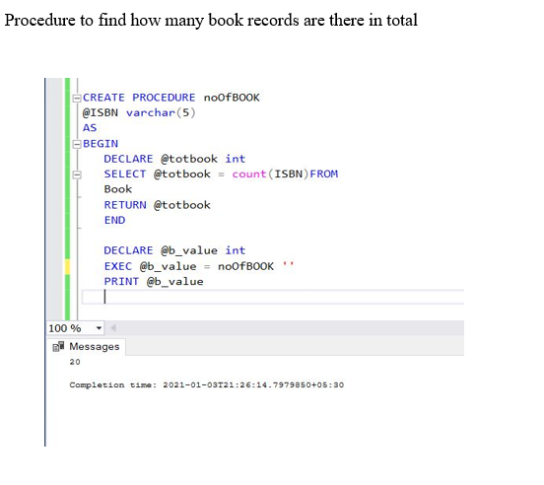

Slide 22
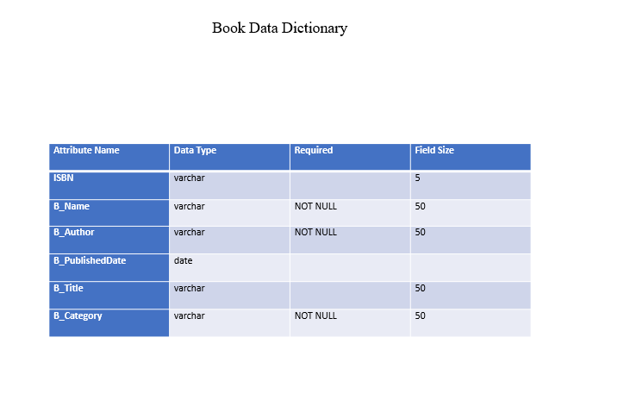

Slide 23
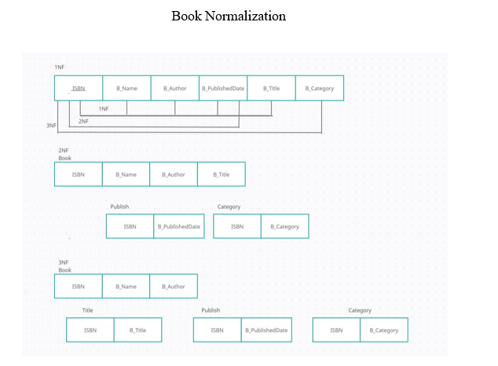

Slide 24
BORROWER TABLE

Slide 25
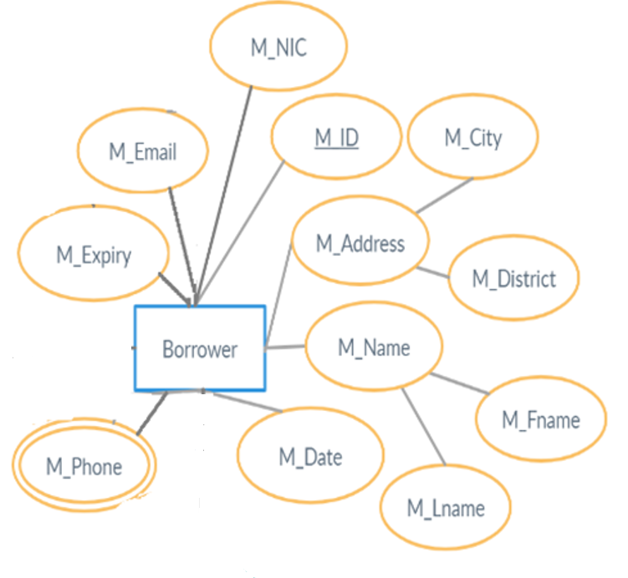
Borrower ER
A borrower can have one or more phone numbers (M_Phone)
A borrower’s address (M_Address) consist of 2 parts city (M_City) & district (M_District), his\hers address can be null.
A borrower’s name (M_Name) consist of 2 parts first name (M_Fname) & second name (M_Lname).
A borrower’s unique NIC (M_NIC), unique email (M_Email), start of membership date (M_Date) and membership expiry date (M_Expiry) is also recorded as it provides clear information and to properly identify the borrower.

Slide 26
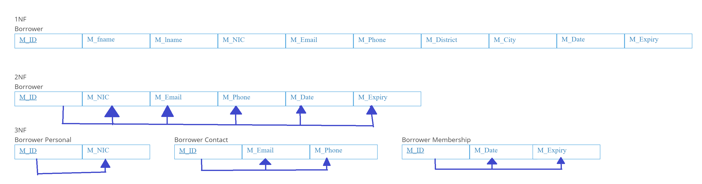
NORMALIZATION TO 3NF
BORROWER TABLE

Slide 27
DATA DICTIONARY
Attribute Name | Data Type | Required | Field Size
M_ID | varchar | NOT NULL | 4
M_NIC | varchar | NOT NULL | 12
M_Fname | varchar | NOT NULL | 15
M_Lname | varchar | NOT NULL | 15
M_Email | varchar | NOT NULL | 50
M_Phone | int | NOT NULL
M_District | varchar | NULL | 20
M_City | varchar | NULL | 20
M_Date | date | NOT NULL
M_Expiry | date | NOT NULL
Borrower

Slide 28
DB DIAGRAM

Slide 29
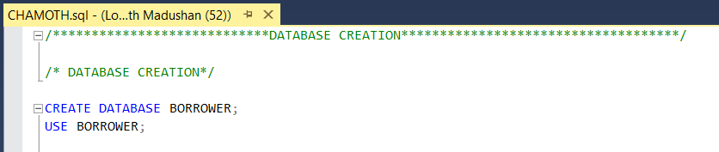
DATABASE CREATION
DATABASE CREATION FOR BORROWER
In this a database named Borrower is created and used to maintain library member information.

Slide 30
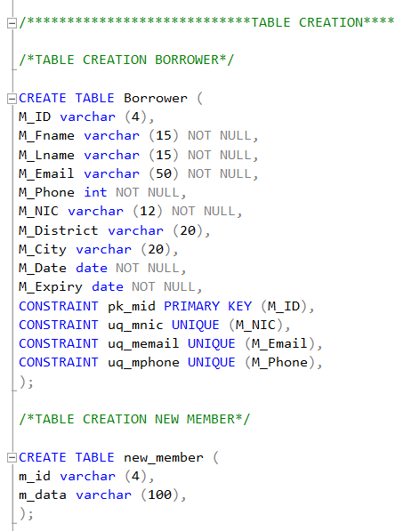
TABLE CREATION FOR BORROWER
Two tables have been created one is the Borrower where the borrowers details are stored & the new_member where all the activities of the information is stored.
Borrower Table Execution
New_member Table Execution

Slide 31
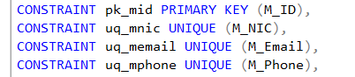
CONSTRAINTS FOR BORROWER TABLE
The Primary Key is the M_ID as it can be used to identify the borrower uniquely and shall be used as the primary key in the table.
NIC is considered as a unique and identification of the borrower.
The email/phone address is also considered as unique as a borrower’s email/phone address cannot be the same of another borrower’s email/phone address.

Slide 32
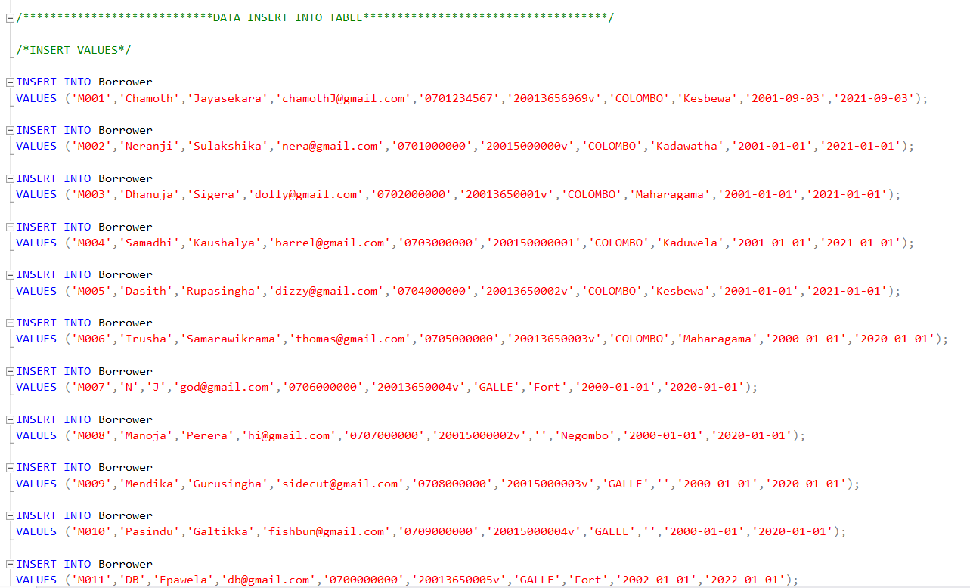
SAMPLE RECORDS OF BORROWER
These are the sample data which has been inserted into the table 20 records in which only 15 have been inserted.

Slide 33
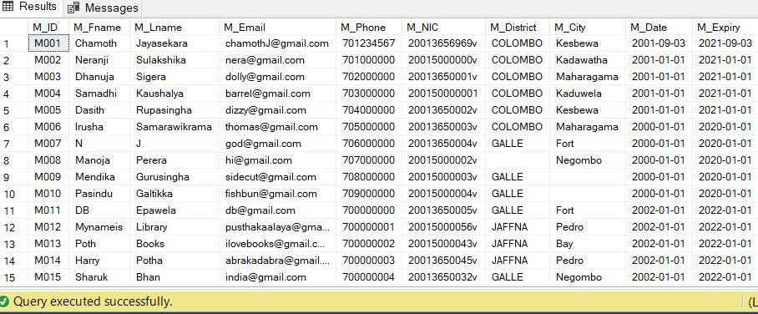
Execution results

Slide 34
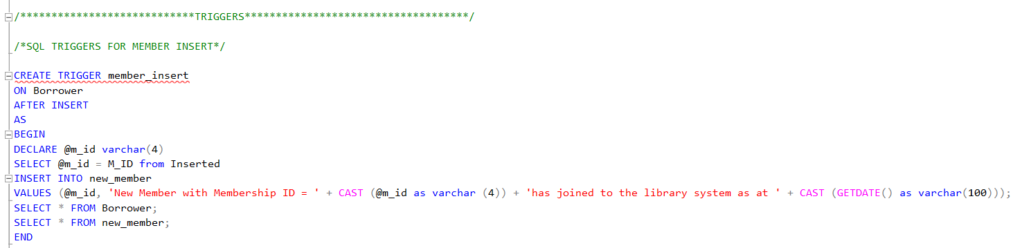
TRIGGERS FOR BORROWER
INSERT TRIGGER
This trigger is created to trigger an event of which when a new member is being entered into the database the borrower table will be shown with the new entry along with another table showing that this person with the related M_ID has been entered into the database.

Slide 35
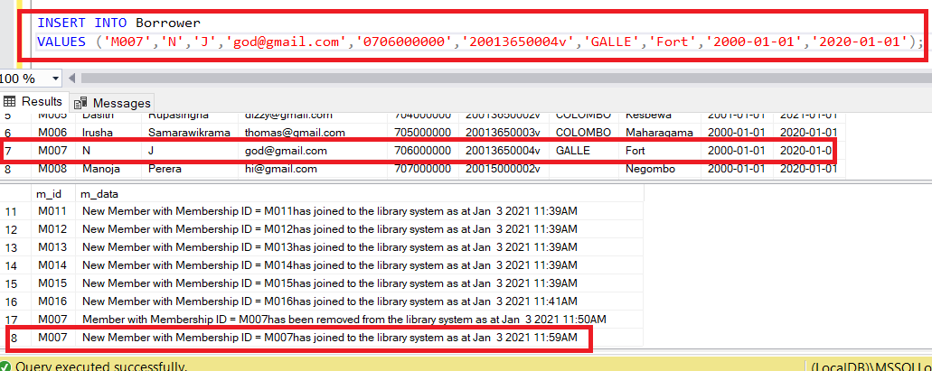
Executed result

Slide 36
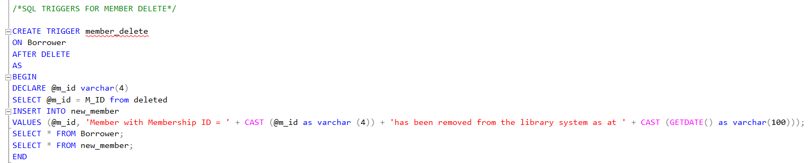
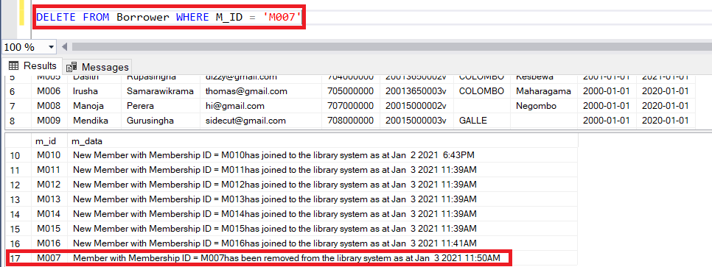
DELETE TRIGGER
This trigger is created to trigger an event of which when a member is being deleted from the database the borrower table will be shown along with another table showing that this person with the related M_ID has been removed from the database. As shown below:
Executed Result

Slide 37
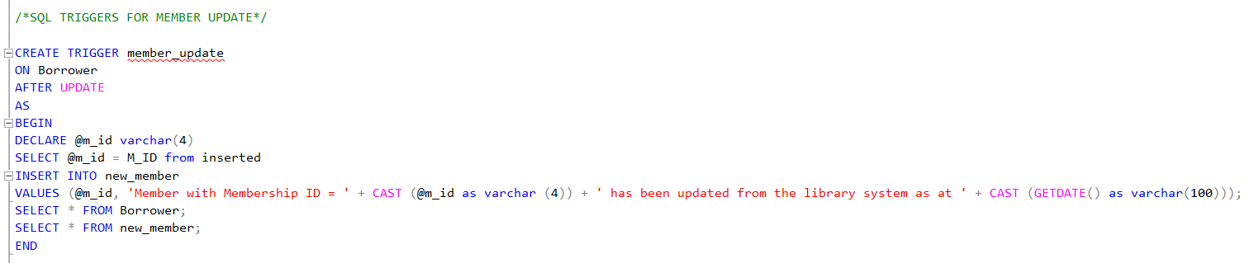
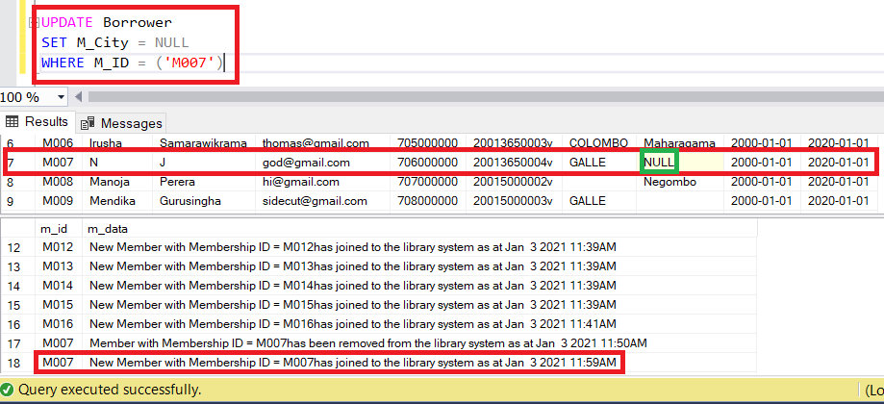
UPDATE TRIGGER
This trigger is created to trigger an event of which when a member’s details is being updated from the database the borrower table will be shown with the newly updated entry along with another table showing that this person with the related M_ID’s details had been updated from the database. As shown below:
Executed result

Slide 38
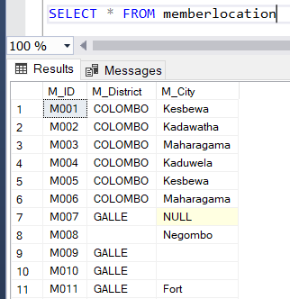
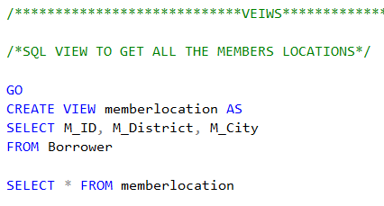
VEIW TO GET MEMBER LOCATION DETAILS
This view is created in-order to get all members location details which includes his/her Membership ID, District and the City.
Execution result

Slide 39
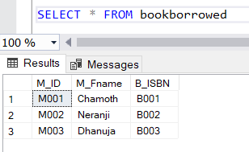
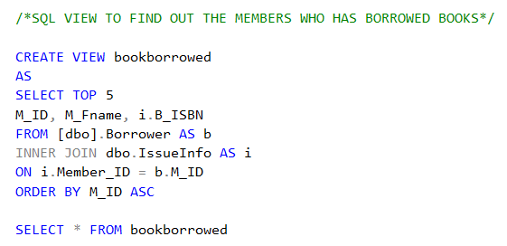
VEIW TO FIND OUT THE MEMBERS WHO BORROWED BOOKS
This view is created to find out which borrowers has borrowed books from the issue info table by doing this we get the borrowers member id first name and the ISBN of the book he/she borrowed.
The Execution result is given below:

Slide 40
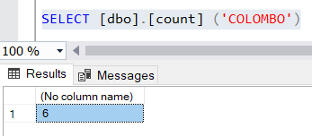
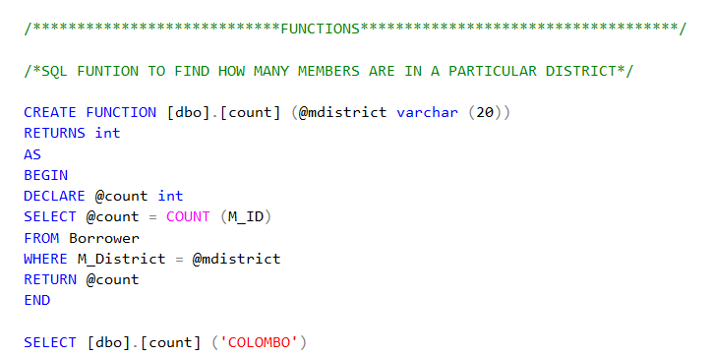
USER DEFINED FUNCTIONS
FUNCTION TO FIND OUT THE COUNT OF MEMBERS IN A DISRTICT
By using this function, we can find out the count of members who comes from a particular district a value needs to be passed either its COLOMBO, GALLE OR JAFFNA. Then the count will be displayed accordingly.
Execution are as follows

Slide 41
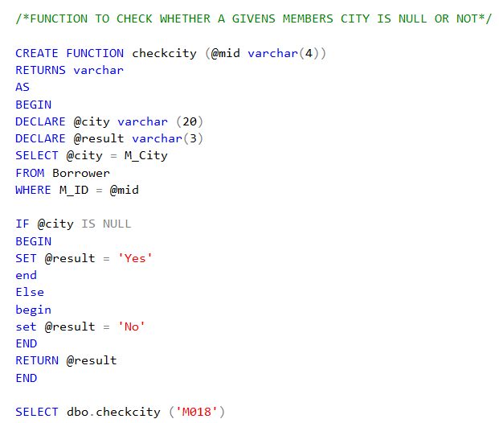
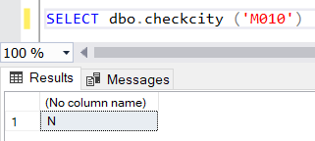
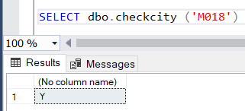
FUNCTION TO CHECK WETHER A PERSON HAS A CITY OR NOT
By using this function we can find out the wether a given members city is given or NULL this can be simply done by passing the members Membership ID into the statement and if its Null its YES and if its NOT NULL then NO.
Execution are as follows.

Slide 42
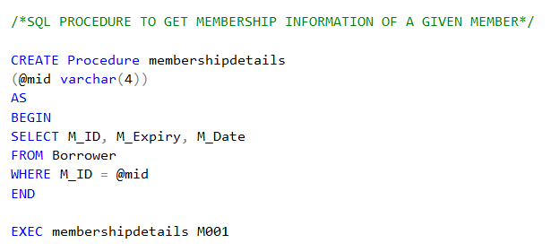
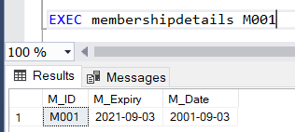
STORED PROCEDURES
PROCEDURE TO GET MEMBERSHIP INFORMATION DETAILS
We can use this procedure to input a members ID and get his/her membership details as it showcase the members joined date and membership expiry date.
Execution details are as follows:

Slide 43
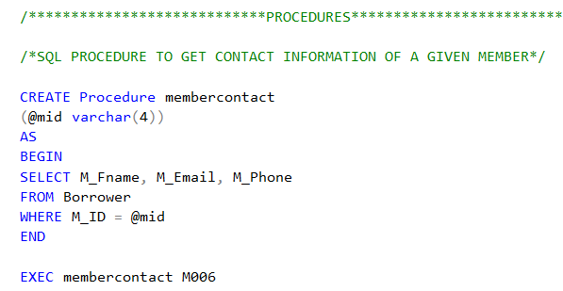
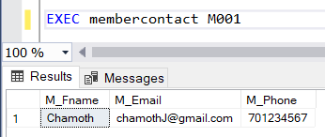
PROCEDURE TO GET CONTACT INFORMATION OF A MEMBER
We can use this procedure to find out a particular member contact information so when a membership ID is being passed the related member will be displayed along with the email address and telephone number of the borrower.

Slide 44
COPY TABLE

Slide 45
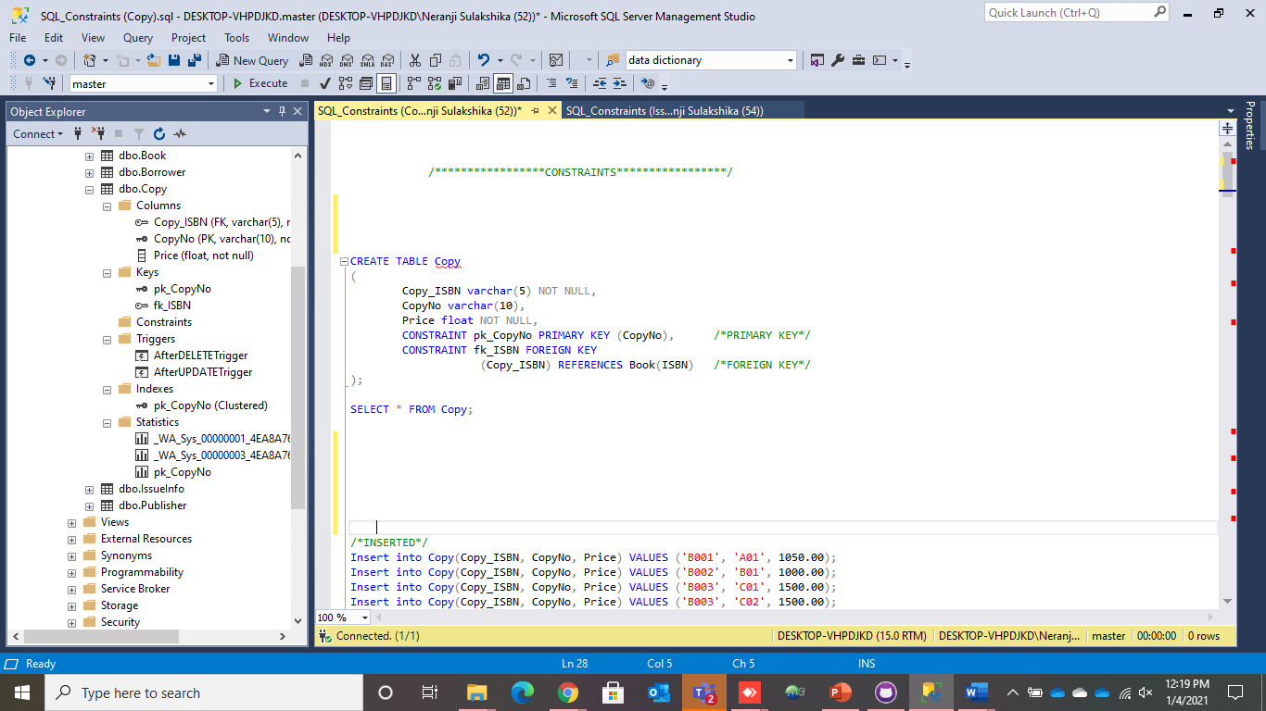
Copy Table
Copy table stores all the copy numbers that are used to refer to a particular book.
The copy numbers are given in relevance to the ISBN of a book.
There are three attributes in this ‘Copy’ table, such as CopyNo(Primary Key), Copy_ISBN(Foreign Key) & Price.
The price attribute is used to store the price of the copy.

Slide 46
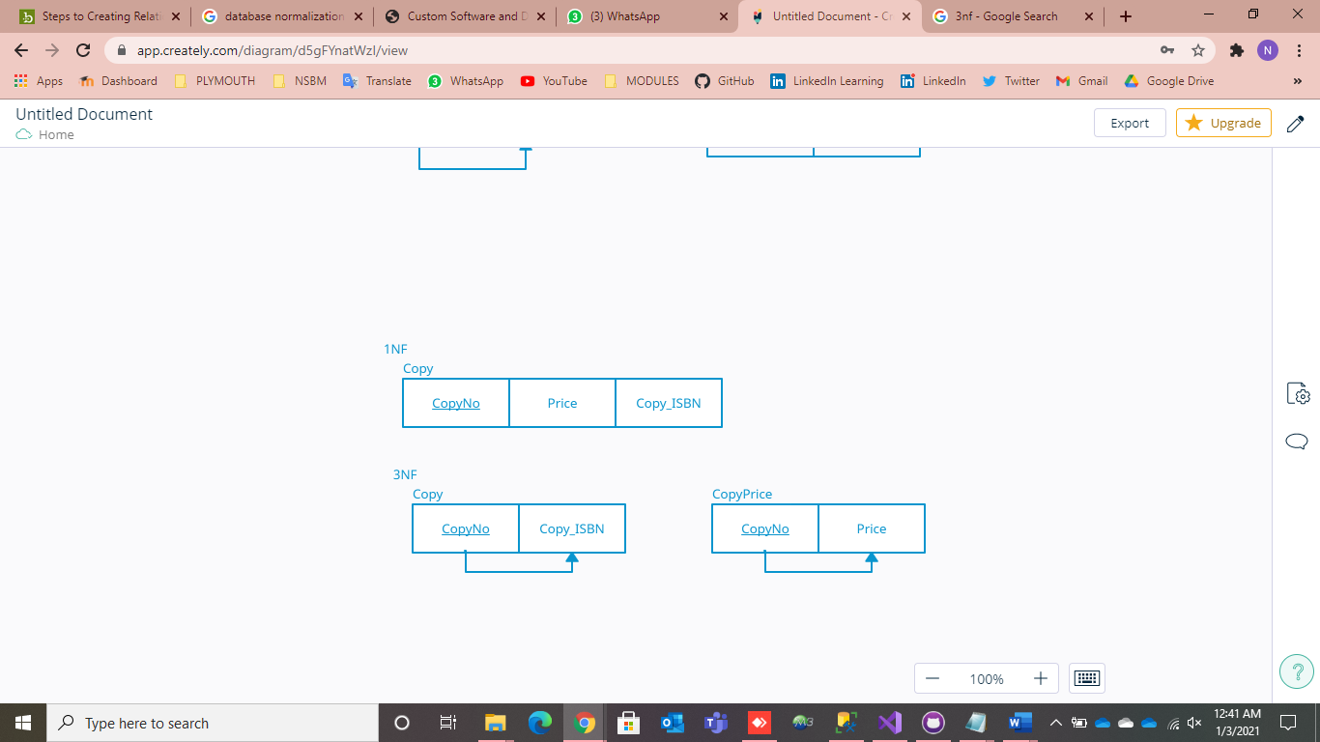
Normalization of ‘Copy’ Table

Slide 47
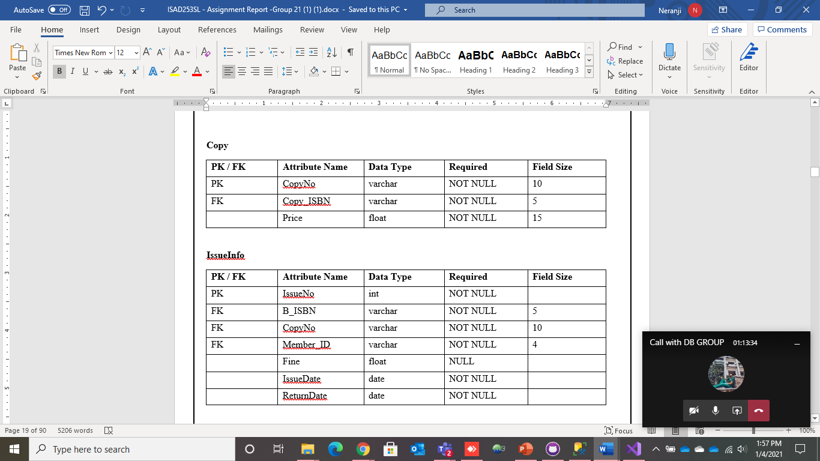
Data Dictionary

Slide 48
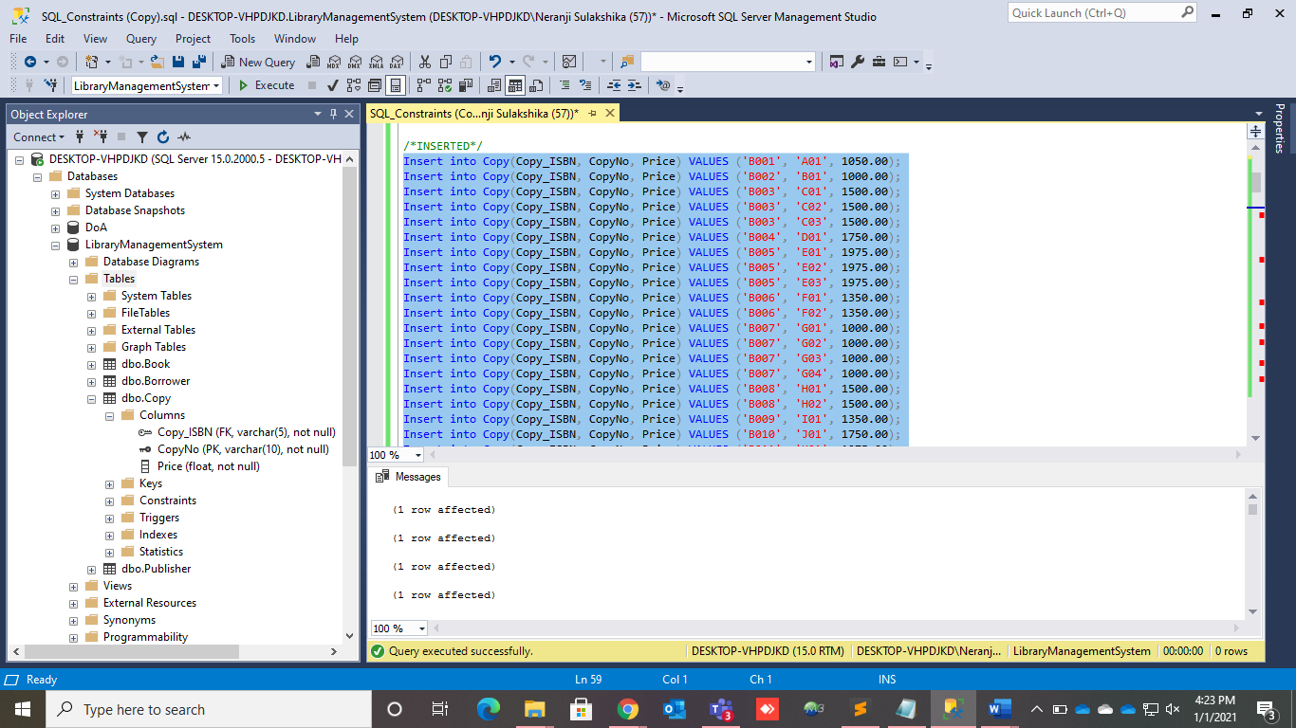
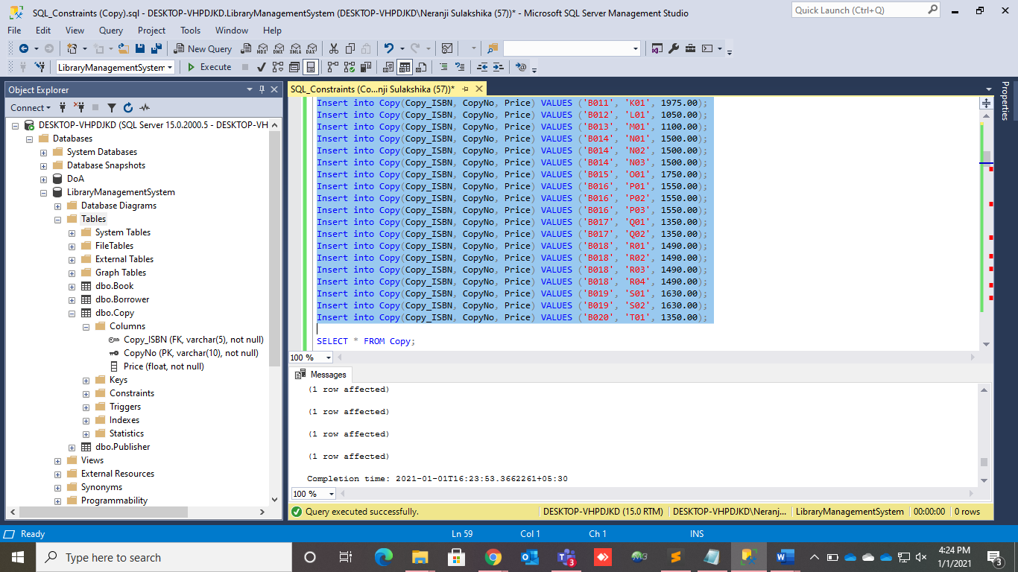
Sample Data of Copy Table
Already inserted sample data of the ‘Copy’ table.

Slide 49
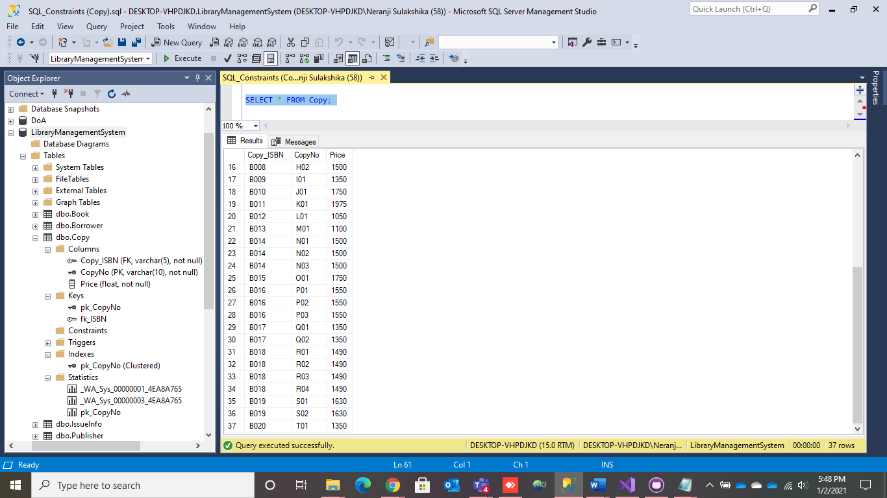

Displaying the entered sample data

Slide 50
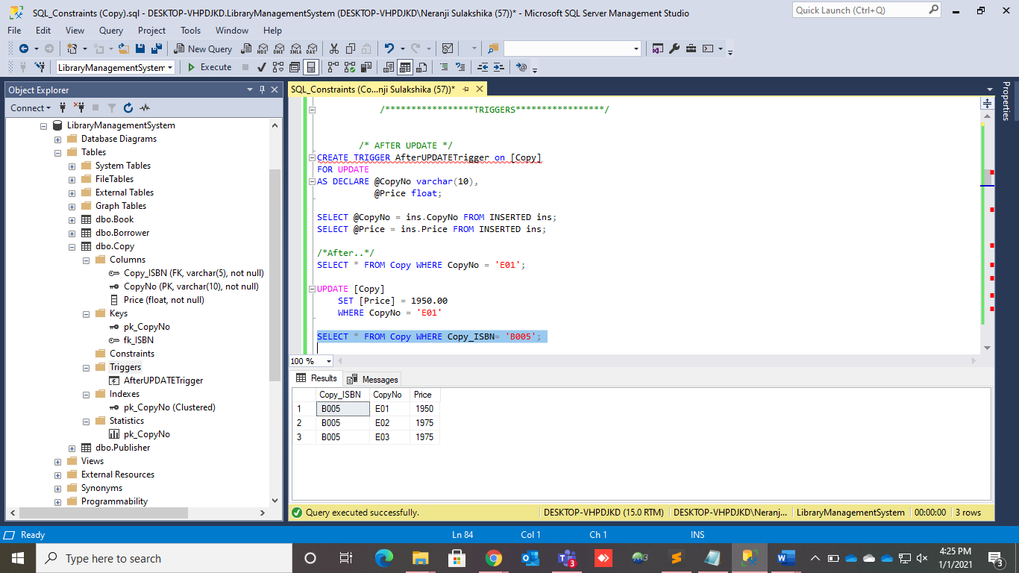
Triggers
After Update Trigger
(Copy Table)

Slide 51

Triggers
After Delete Trigger
(Copy Table)

Slide 52

Views
Create View ‘CopyViewQuery’

Slide 53

Views
Create View ‘PriceView’

Slide 54


Functions
Create Function ‘SummationOfBookPrice’

Slide 55


Functions
Create Function
‘LibraryCopy’

Slide 56



Procedures
Create Procedure ‘SelectStoredProcedureCopy’

Slide 57





Slide 58




Procedures
Create Procedure ‘UpdateStoredProcedureCopy’

Slide 59
ISSUE-INFO TABLE

Slide 60

IssueInfo Table
‘IssueInfo’ table records all the books that have been issued to the members.
An ‘IssueNo’ is given to every issuing of the books.
This table also keeps track of return dates and fines.
There are seven attributes in this ‘IssueInfo’ table, such as IssueNo(Primary Key), B_ISBN(Foreign Key), CopyNo(Foreign Key), Member_ID(Foreign Key), Fine, IssueDate & ReturnDate.

Slide 61

‘IssueInfo’ Table EER with Assumptions
Added ‘IssueInfo’ table to save issued books data.
An ‘IssueInfo’ table attributes are Issue number (IssueNo- which is increment automatically), Fine, Issue date (IssueDate), Return date (ReturnDate).

Slide 62

Normalization of ‘IssueInfo’ Table

Slide 63

Data Dictionary

Slide 64


Sample Data of ‘IssueInfo’ Table

Slide 65

Triggers
After Update Trigger

Slide 66

Triggers
After Delete Trigger

Slide 67

Views
Create View ‘CreateIssueInfoMemberView’

Slide 68

Views
Create View
‘CreateFineView’

Slide 69


Functions
Create Function ‘SummationOfFine’

Slide 70



Functions
Create Function
‘CheckFine’

Slide 71




Procedures
Create Procedure ‘SelectStoredProcedureIssueInfo’

Slide 72






Slide 73


Procedures
Create Procedure ‘UpdateStoredProcedureIssueInfo’

Slide 74

Issue Book Interface
When the Member ID is entered and after clicked on the ‘SEARCH’ button, member details will be displayed.
When the Book ISBN is entered and after clicked on the ‘CHECK’ button, the copies of that book will be displayed in the ‘DataGridView’ and the return date is automatically generated.
When we enter the relevant copy number, the copy will be added to the issue details.
Finally, we can click on the ‘ISSUE’ button and issue the book. If the issuing is successful, we will get a popup message. An issue number will be auto generated.

Slide 75




Warnings & Error Messages
Display a warning message, when the ISBN textbox is empty.
If the Member ID is invalid, an error message will popup.
Display a warning message, when the Member ID textbox & Copy No textbox are empty.
If the selected copy number is already issued, an error message will popup.

Slide 76
PUBLISHER TABLE

Slide 77


CREATION OF PUBLISHER TABLE WITH CONSTRAINTS
DISPLAYING BOOK AND THE PUBLISHER TABLE

Slide 78

INSERTING VALUES TO THE PUBLISHER

Slide 79

DISPLAYING THE ENTERED RECORDS

Slide 80

TRIGGERS

Slide 81

VALUES INSERTED AND THE RESULTS OF USING THE TRIGGER

Slide 82

TRIGGER TO UPDATE AN EXISTING PUBLISHER RECORD

Slide 83

DELETION OF A TRIGGER

Slide 84

TRIGGER TO GET THE CURRENT DATE

Slide 85

THE RESULT AFTER EXECUTING THE VIEW PUBLISHER

Slide 86

CREATION AND THE RESULT OF A VIEW TO FIND THE PUBLISHERS BY COUNTRY

Slide 87

CREATING VIEWS BY USING MULTIPLE TABLES

Slide 88

CREATION OF A FUNCTION

Slide 89

CREATION OF A FUNCTION BY USING PUBLISHER’S COUNTRY

Slide 90

PROCEDURE TO FIND THE PUBLISHER BY PUBLISHER’S ID

Slide 91

PROCEDURE TO FIND THE NUMBER OF PUBLISHERS

Slide 92

Normalization of Publisher

Slide 93


Slide 94


Slide 95
LIBRARY TABLE

Slide 96

Creating the table
The data is entered to the table like the following
We should CREATE TABLE first.
Declare the fields and constraints we need.
Finally mention their data types eg.(INT, VARCHAR)

Slide 97

Inserting the sample data

Slide 98

The insert trigger
The Insert trigger adds the new data into the table.

Slide 99

The update trigger
Update trigger changes the table with a value which is in the existing table.

Slide 100


Views
The above view statement that I’ve created in this query displays the values of the first 3 libraries in the table.
The above sql statements are used to create a view which filters to get the BranchAddress of the libraries in the city colombo

Slide 101


Functions
This above user defined function finds the number of Libraries in a city .
The above statements are for the second function which filters for the number of public libraries available in the table.

Slide 102


Stored procedures
This procedure was created in order to find and store all the values for the future the main libraries (main) in the table (library)
This stored procedure that I’ve created to find the (BranchType ‘school’) from the selected table ( library)

Slide 103
STAFF TABLE

Slide 104

Creating a database
Creating a Database can be done in using following sql query,

Slide 105

Creating a table for Staff

Slide 106
Creating a table for Staff
Staff ID set as a primary key.
Made few constraints names, pk_staffid for primary key, u_email for email to set as an unique filed and finally u_fullname to make the full name as an unique field.
Only email is set NULL but rest are NOT NULL.
Staff ID would likely to be increment by 1.

Slide 107

Creating a table for authentication system.

Slide 108

Creating a table for authentication system.
In creating table for authentication system, StaffID, username and password as attributes.
Set StaffID as a foreign key through giving constraint name.

Slide 109

Inserting sample data into Staff Table.

Slide 110

Inserting sample data into Staff Table.
When inserting data into the table I can skip entering the email field as I have settled into NULL field.
StaffID’s should not to insert into this as it’s already inserted automatically with increment.
The result can be like this,

Slide 111

Creating After Insert Trigger
Created after insert trigger to insert the data into a table for new members that having only Staff Id and Joined Date.

Slide 112

Creating After Insert Trigger
So with that I can find who the staff members who joined recently.

Slide 113


Creating After Update/ After Delete triggers

Slide 114


Execution window after update and delete
With those triggers being created the execution window will be shown as,

Slide 115

Creating Views for Staff Table
Creating View for to extract administrators but without the credentials.

Slide 116


Execution window for admin info without credentials
With previously created view, you can find the admin info without credentials.

Slide 117


Creating a view to find the old members
I created an another view the old members. I considered here that staff members who have joined since more than a year.

Slide 118

Creating functions
Created a function to search the information just hitting by Staff ID.
Creating functions can make yourself easy to search information just hitting by a desired key like an example as Staff ID.

Slide 119


Execution for function
After creating the function the execution can done by,
The execution can be shown as,

Slide 120

Creating another function to find the joined date.
This should can be done within hitting by staff id.

Slide 121


Execution window for function
And the execution part can be done through this,

Slide 122

Creating a procedure for admin info with credentials
I used staff id here because it helps to view whole staff members’ info those who have credentials but this time with the credentials too.
To this I used create procedure function as it joins both StaffTable and AuthSys table,

Slide 123

Execution window for the procedure
With this, result has to be executed by using following,
The result can be like this,

Slide 124

Creating procedure for a list
Now, I created another interesting feature that able to view whole information by any single attribute or multiple attributes.
For example like this below, I expect to extract only details from book keepers in library,

Slide 125


Execution Window
With that to execute with following command,
And the result is,

Slide 126
THANK YOU

